Slide 1

Node.js
IRIS-4 DOCU Node.js & Express learning group
jack y yu, Leo x liu, leo Z li, Lance zhou

Slide 2
Agenda
Preface
Introduction of Node.js
What’s the Module
ES6 features
Standard

Slide 3
About web development
LAMP—Linux Apache Mysql Php
OOJL—Oracle Oracle Java Linux
MEAN—MongoDB Express AngularJs Node.js

Slide 4
What is a MEAN stack
MongoDB as the database
Express as the web framework
AngularJS as the frontend framework, and
Node.js as the server platform

Slide 5
The advantages of MEAN stack
Support for the MVC pattern
JSON is used for transferring data
Node.js's huge module library(200k+)
Open source
Single language is used in the whole application
Notes:
Open source, so you can tweak it to your preferences if you're an experienced user

Slide 6
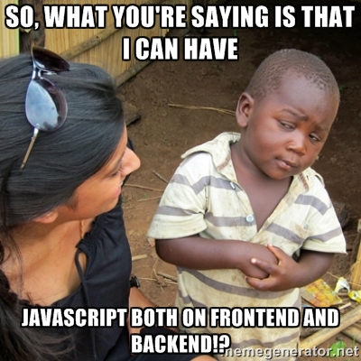
Notes:
If you have the question like this, the answer is YES.

Slide 7
What’s the Node.js
is a open-source, cross-platform runtime environment built on top of Chrome’s V8 JavaScript engine
is for developing server-side web application
operates on single thread but can create highly scalable servers
is using in these companies
IBM, Microsoft, Yahoo!, Walmart, Groupon, SAP, LinkedIn, PayPal…
Notes:
can be distributed in Mac OS X, Unix, Window, IOS and Android
V8 compiles JavaScript source code to native machine code instead of interpreting it in real time
JavaScript is a single threaded programming language, single threaded Runtime, it has a single call stack. And it can do one thing at a time, that's what a single thread means, the program can run one piece of code at a time.
using non-blocking I/O calls, allowing it to support tens of thousands of concurrent connections without incurring the cost of thread context switching, instead of processes or threads
A downside of this single-threaded approach is that Node.js doesn't allow scaling with the number of CPU cores of the machine it is running on without using an additional module such as cluster, StrongLoop Process Manager, or pm2. However, developers can increase the default number of threads in the libuv threadpool, those threads likely to be delegated to multiple cores by the server operating system.
https://github.com/nodejs/node-v0.x-archive/wiki/Projects,-Applications,-and-Companies-Using-Node
https://www.paypal-engineering.com/2013/11/22/node-js-at-paypal/

Slide 8
History of the Node.js
2009, by Ryan Dahl for Linux
2011, native Windows version
Till now
Notes:
Node.js was invented in 2009 by Ryan Dahl and other developers working at Joyent.
In June 2011, Microsoft and Joyent implemented a native Windows version of Node.js.

Slide 9
What Node.js is good at
Data Intensive and Real Time Applications
JSON APIs
Data-streaming Applications
Notes:
Bower, (maven sth.? package.json == pom.xml?)
Online repositories for node.js packages/modules which are searchable on search.nodejs.org
Command line utility to install Node.js packages, do version management and dependency management of Node.js packages.

Slide 10
What Node.js Is Not Good At
Heavy computation scenario
Application with Relational DB behind

Slide 11
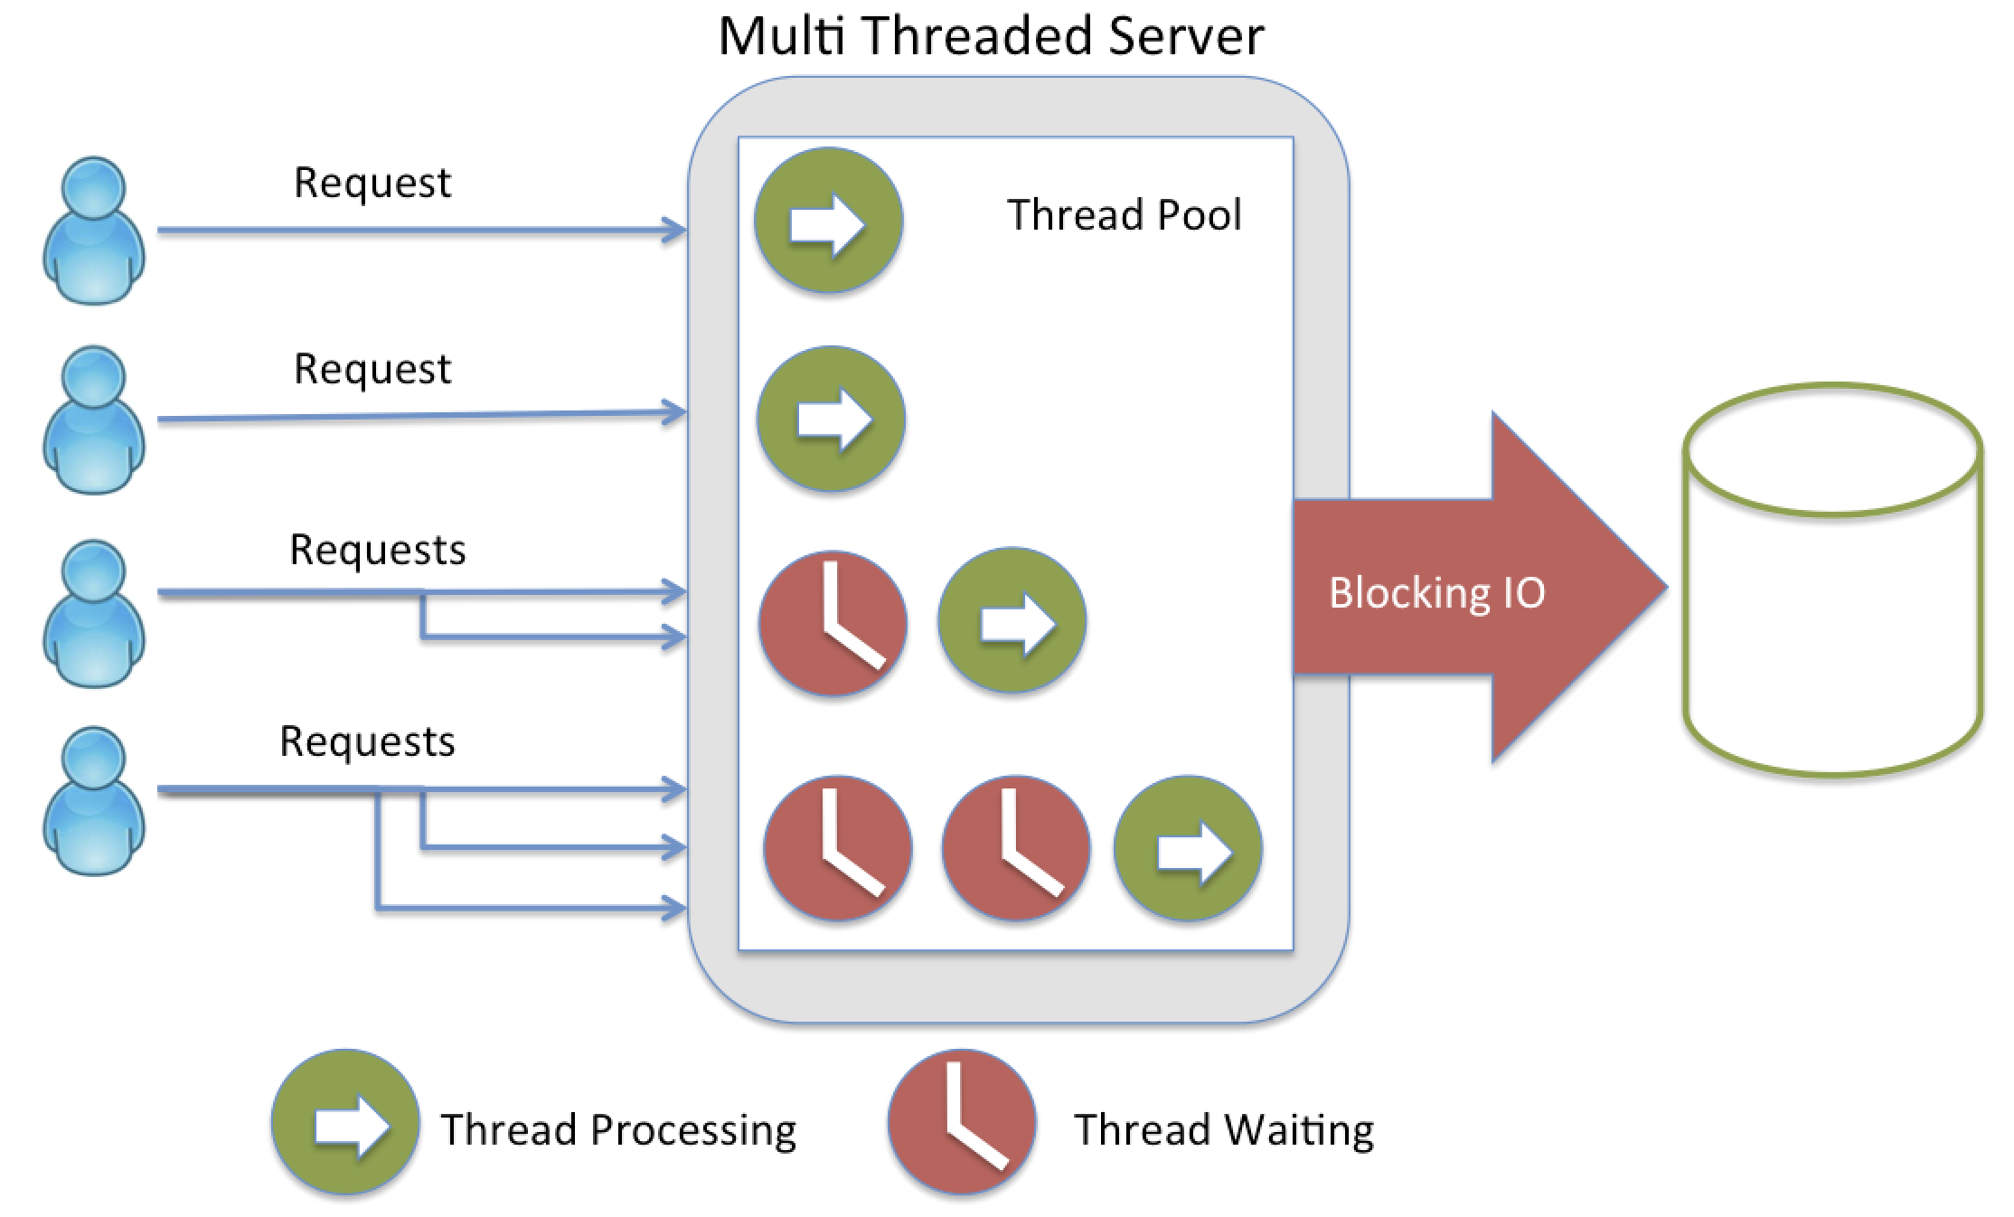
Node.js server VS traditional server
Notes:
A quick calculation: assuming that each thread potentially has an accompanying 2 MB of memory with it, running on a system with 8 GB of RAM puts us at a theoretical maximum of 4000 concurrent connections, plus the cost of context-switching between threads. That’s the scenario you typically deal with in traditional web-serving techniques. By avoiding all that, Node.js achieves scalability levels of over 1M concurrent connections (as a proof-of-concept).

Slide 12
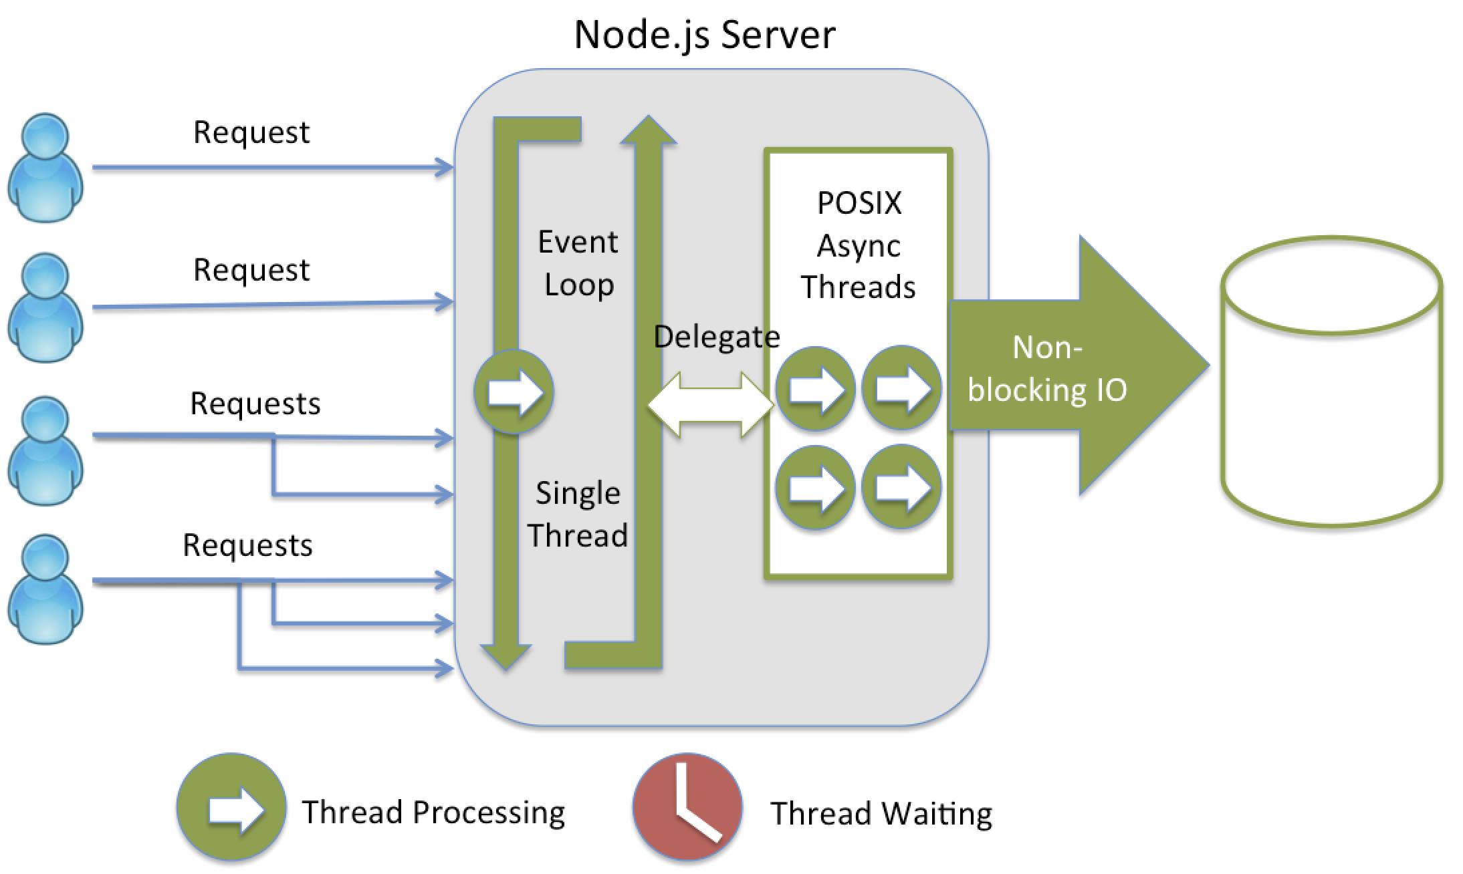
Node.js server VS traditional server
Notes:
A quick calculation: assuming that each thread potentially has an accompanying 2 MB of memory with it, running on a system with 8 GB of RAM puts us at a theoretical maximum of 4000 concurrent connections, plus the cost of context-switching between threads. That’s the scenario you typically deal with in traditional web-serving techniques. By avoiding all that, Node.js achieves scalability levels of over 1M concurrent connections (as a proof-of-concept).

Slide 13
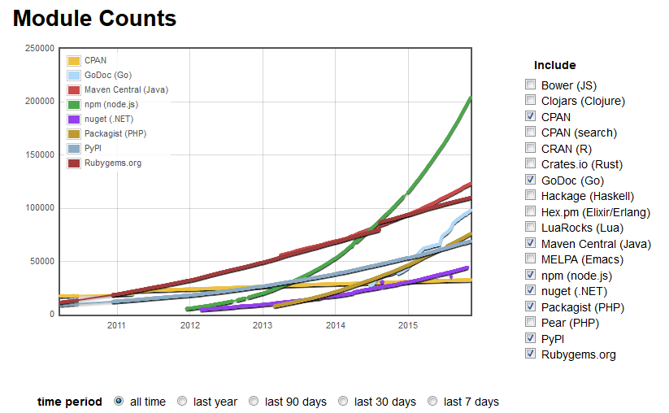
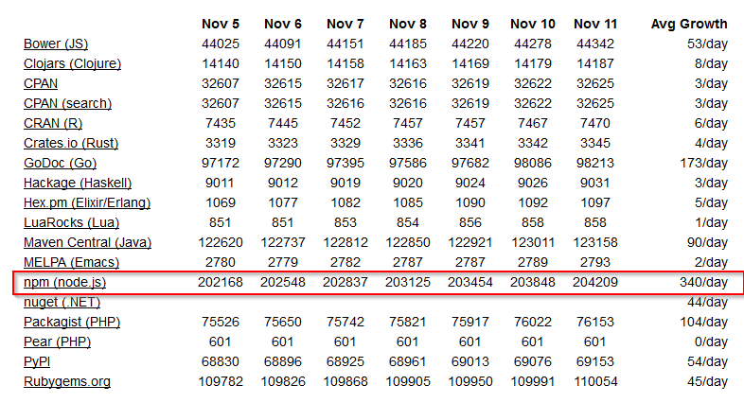
What makes Node.js so popular
Asynchronous, event-driven and none-blocking I/O model
Modularization(Node Package Manager )
Notes:
1st, there is requirment and node.js fit it then it rocks
200K+ Modules
Event Loop : Written in C++ using the Marc Lehman’s libev library, the event loop use epoll or kqueue for scalable event notification mechanism.

Slide 14
What’s the heck of Event Loop
Loupe @philip_roberts
https://github.com/latentflip/loupe
https://www.youtube.com/watch?v=8aGhZQkoFbQ
Notes:
how JavaScript's call stack/event loop/callback queue interact with each other.

Slide 15
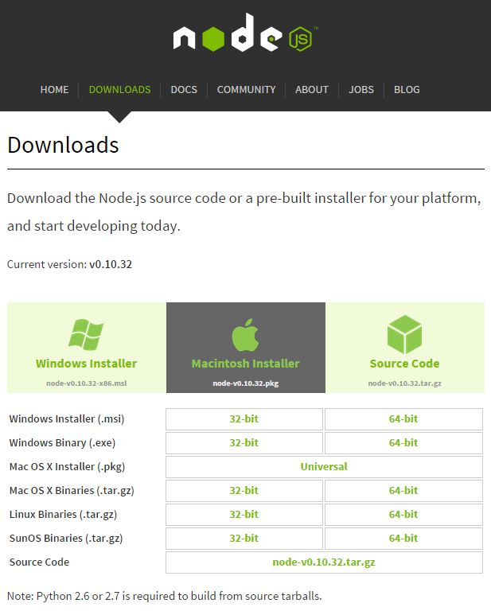
How to start Node.js journey
Install related OS version of Node.js from http://nodejs.org/

Slide 16
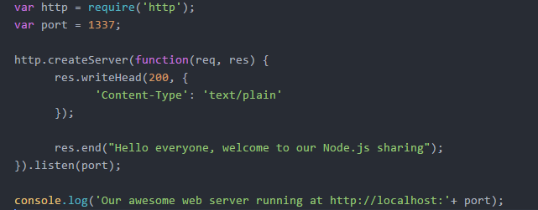
Node.js Development Style

Slide 17
References
https://hackhands.com/how-to-get-started-on-the-mean-stack/
https://hackhands.com/delving-node-js-express-web-framework/
https://strongloop.com/strongblog/node-js-is-faster-than-java/
http://www.tutorialspoint.com/nodejs/

Slide 18
Node Module
Leo z li

Slide 19
Contents
Basic concept of module
require、exports、module
The rule of module path
Core Modules
File Modules

Slide 20
Node Module
Main Module：scheduling other modules
Binary Module：C/C++; .node & .js
Package：multiple sub modules
Core Modules：events, fs, http
File Modules：express, socket.io
Notes:
编译好的二进制模块除了文件扩展名是.node外，和JS模块的使用方式相同。二进制模块能使用操作系统提供的所有功能，拥有无限的潜能。
核心模块： 内置模块，二进制文件，加载的速度最快。
文件模块是动态加载的，加载速度比原生模块慢。

Slide 21
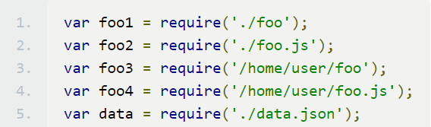
Node require
Core Modules
var http = require(‘http’);
File Modules
$ npm install express
Notes:
预定义变量

Slide 22
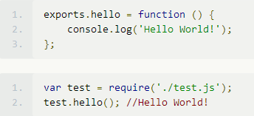
Node exports & Module.exports
Exports is the export object of the current module
Public properties and methods

Slide 23
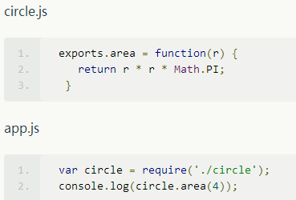
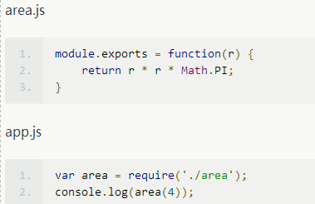
Exports & Module.exports
exports = module.exports = {};
exports = function(r){…}?

Slide 24
Node.js Events
var EventEmitter = require('events');
Events module only exports one object——EventEmitter
EventEmitter：emitter.emit() emitter.on() like js
Emitters should be limited to 10
emitter.setMaxListeners(n)
Notes:
Events模块是Node中最重要的模块，其他模块都引用此模块，Events模块只对外暴露一个对象EventEmitter 英[ɪ'mɪtə]

Slide 25
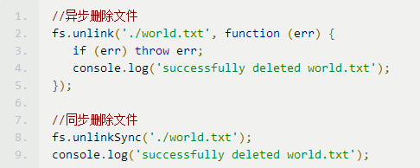
Node.js File System
var fs = require('fs');
Stream: createReadStream()和 createWriteStream()
Notes:
POSIX 可移植性操作系统接口
文件系统模块是一个简单包装的标准 POSIX 文件 I/O 操作方法集。通过调用require('fs')来获取该模块。文件系统模块中的所有方法均有异步和同步版本。
Fs系统中重要的stream： 处理数量级很大的文件时可以减少内存开销，避免内存溢出。
文件系统模块中的异步方法需要一个完成时的回调函数作为最后一个传入形参，通常情况下回调函数的第一个形参为返回的错误信息。 如果异步操作执行正确并返回，该错误形参则为null或者undefined。
Fs系统中重要的stream： 处理数量级很大的文件时可以减少内存开销，避免内存溢出。
createReadStream()和 createWriteStream()

Slide 26
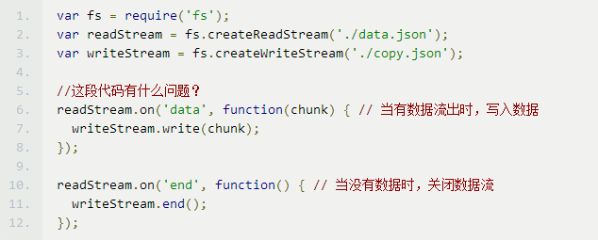
Node.js File System
读
写
Notes:
POSIX 可移植性操作系统接口

Slide 27
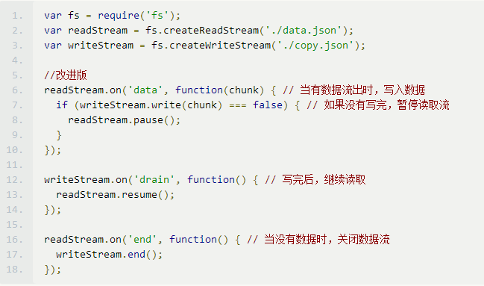
Node.js File System
Notes:
POSIX 可移植性操作系统接口

Slide 28


Node.js 0.10.X Pipe
测试环境 | CPU:I5 内存:8G 硬盘:HDD
文件 | Eclipse.rar
size | 822 MB
时间 | Stream:9.031s Pipe:6.230s
Notes:
默认情况下，Node 会尽可能使用「拉」模式，也就是说只有 pipe 链末端的流消费者真正需要数据的时候，数据才会从源头被取出，然后顺着管子一路到达消费者。

Slide 29
Node.js Http
Create a web server :
http.createServer();
var server = new http.Server();
Create a node client as crawler:
http.request();
http.get();
http

Slide 30
ECMAScript 6
New features in V8
LEO x liu

Slide 31
JavaScript features
Prototype
Weak typing
Function
Closure
Single-threaded
Global variable
Hoisting

Slide 32
New in ES6
Block scoping
Classed (strict mode only)
Symbol
Collections
Promises
Arrow functions
Template strings

Slide 33
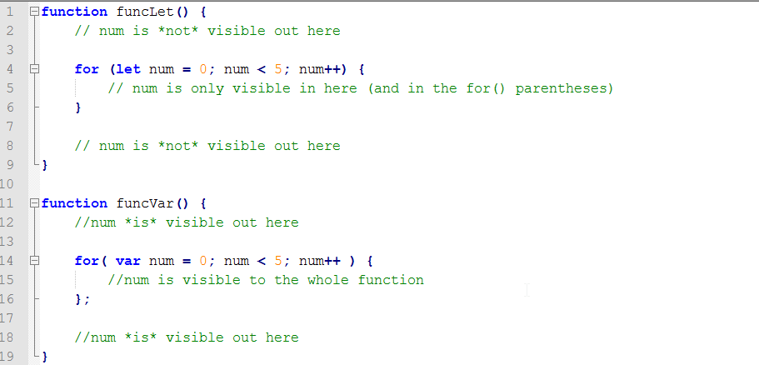
Block Scope – let (strict mode only)
Declare variables that are limited in scope to the block, statement, or expression which it is used.
No hoisting
Block =>function, for loop, if-else, etc.
Notes:
http://cookfront.github.io/2015/05/28/es6-let-const/
http://www.codesec.net/view/165972.html
http://blog.csdn.net/lcstrive/article/details/43149167

Slide 34
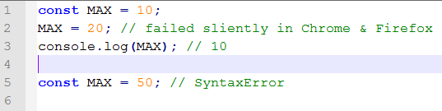
Block Scope – const
Declare a read-only reference to a value
Initialized is needed
Notes:
http://segmentfault.com/a/1190000000515168

Slide 35
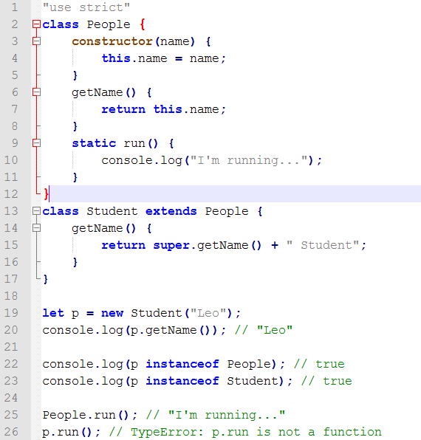
Classed (strict mode only)
In fact functions
No hoisting
Support inheritance (extends, super)
Support static method
Getter / setter

Slide 36
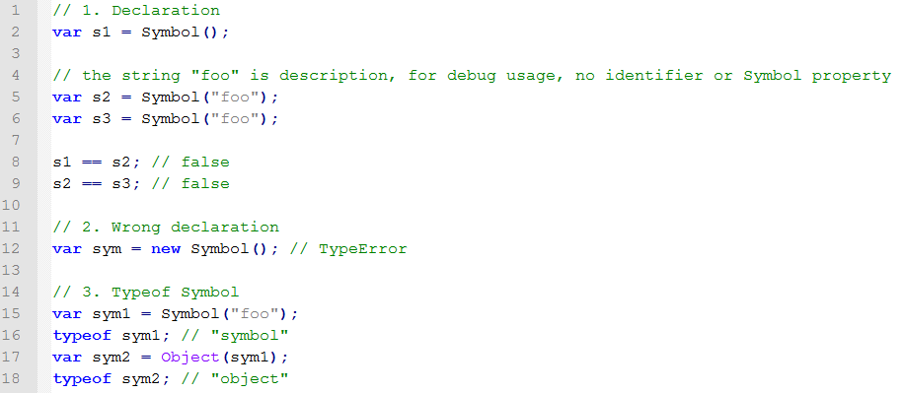
Symbol
New primitive data type
Unique & immutable
Can be object/map key, but in Object, can’t be found in for…in
Notes:
http://www.jb51.net/article/70145.htm

Slide 37
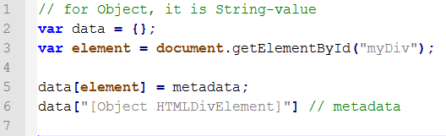
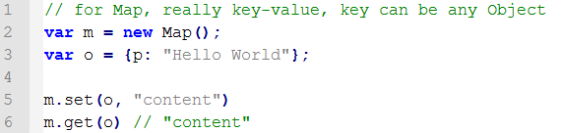
Collections
Map/Set
WeakMap/WeakSet
Key is object
Primitive date type can’t be key
GC

Slide 38
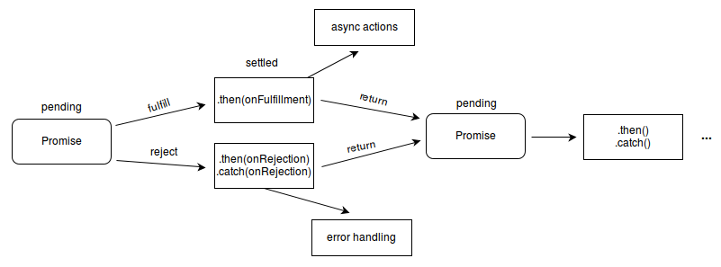
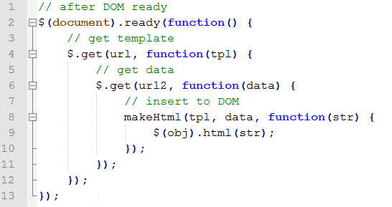
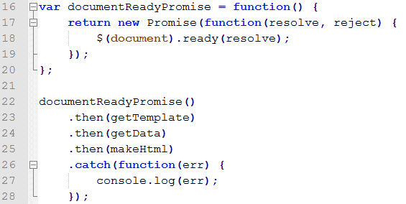
Promises
Used to deferred and asynchronous computations
A transaction with 3 state: pending, fulfilled, rejected
Avoid callback hell

Slide 39
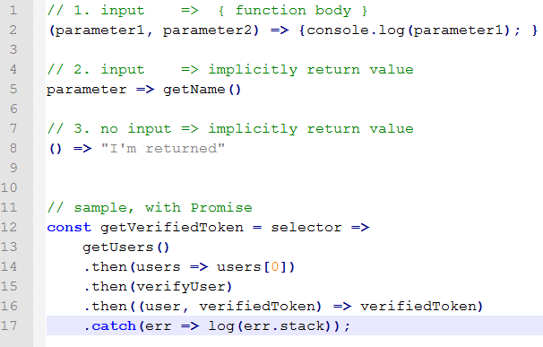
Arrow Functions
([parameters]) => {function body}
Share parent this
Notes:
http://segmentfault.com/a/1190000003781467
http://www.cnblogs.com/Wayou/p/es6_new_features.html

Slide 40
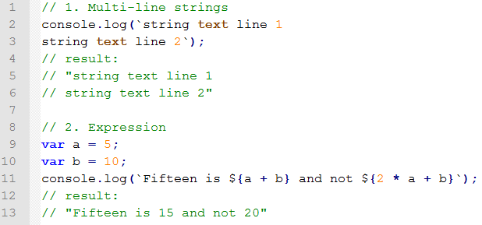
Template Strings
Declared by ` `
Support expression ${ expression }

Slide 41
Reference
http://es6.ruanyifeng.com/
https://developer.mozilla.org/zh-CN/docs/Web/JavaScript/Reference

Slide 42
Standard
Jack y yu

Slide 43
Standard
JavaScript no module system. There is no native support for confined area or dependency management.
JavaScript no standard library. In addition to some of the core library, no file system API, no IO API, etc..
JavaScript no standard interface. No uniform interface, such as Server Web or database.
JavaScript no package management system. Can not automatically load and install dependency.
Notes:
JavaScript没有模块系统。没有原生的支持密闭作用域或依赖管理。
JavaScript没有标准库。除了一些核心库外，没有文件系统的API，没有IO流API等。
JavaScript没有标准接口。没有如Web Server或者数据库的统一接口。
JavaScript没有包管理系统。不能自动加载和安装依赖。

Slide 44
CommonJS
Modules
Binary strings and buffers
Charset encodings
Binary, buffered, and textual input and output (io) streams
System process arguments, environment, and streams
File system interface
Socket streams
Unit test assertions, running, and reporting
Web server gateway interface, JSGI
Local and remote packages and package management
Notes:
CommonJS 规范（模块，二进制，buffer,字符集编码，I/O流，进城环境，文件系统，套接字，单元测试，web服务器网关接口，包管理等）

Slide 45
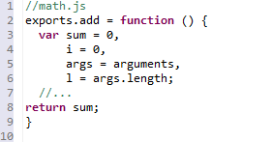
Node Module
NativeModule (http,fs)
FileModule
Notes:
Node.js自身实现了require方法作为其引入模块的方法，同时NPM也基于CommonJS定义的包规范，实现了依赖管理和模块自动安装等功能。
核心模块 启动时加载到内存 http,fs （C/C++ 在src下， javaScript 在lib下）
文件模块 运行时动态加载 . .. / 自定义模块
.js。通过fs模块同步读取js文件并编译执行。
.node。通过C/C++进行编写的Addon。通过dlopen方法进行加载。
.json。读取文件，调用JSON.parse解析加载。

Slide 46

Node Module
Module Introducing and loading
Notes:
模块引入：路径分析，文件定位，编译执行
载入内置模块（A Core Module）
var http = require('http')
载入文件模块（A File Module）
var myMod = require('/home/base/my_mod')
var myMod = require('./my_mod')
载入文件目录模块（A Folder Module）Node会假设folder为一个包并试图找到包定义文件package.json。如果folder目录里没有包含package.json文件，Node会假设默认主文件为index.js，即会加载index.js。如果index.js也不存在，那么加载将失败。
var myMod = require('./folder')
载入node_modules里的模块，如果模块名不是路径，也不是内置模块，Node将试图去当前目录的node_modules文件夹里搜索。如果当前目录的node_modules里没有找到，Node会从父目录的node_modules里搜索，这样递归下去直到根目录。
自动缓存已载入模块

Slide 47
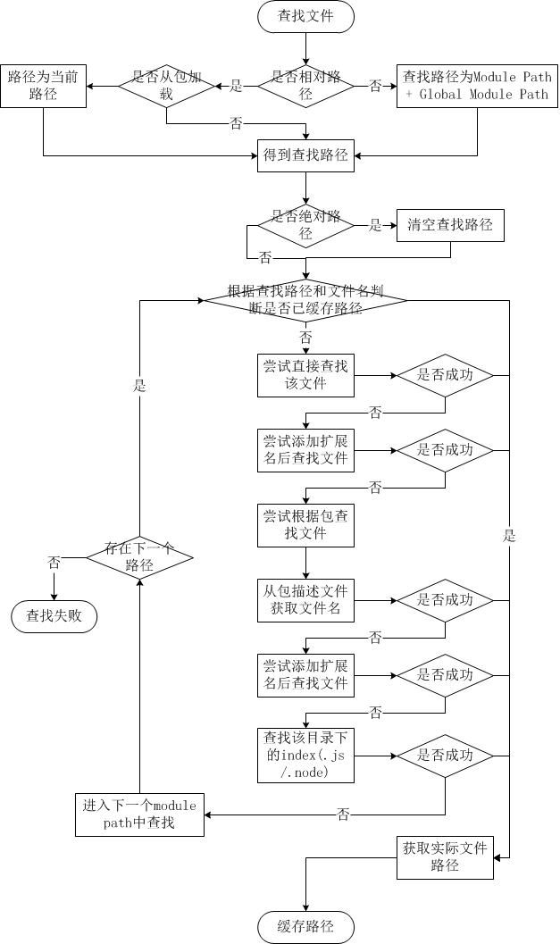
Node Module—Find File Strategy
Notes:
模块引入：路径分析，文件定位，编译执行
载入内置模块（A Core Module）
var http = require('http')
载入文件模块（A File Module）
var myMod = require('/home/base/my_mod')
var myMod = require('./my_mod')
载入文件目录模块（A Folder Module）Node会假设folder为一个包并试图找到包定义文件package.json。如果folder目录里没有包含package.json文件，Node会假设默认主文件为index.js，即会加载index.js。如果index.js也不存在，那么加载将失败。
var myMod = require('./folder')
载入node_modules里的模块，如果模块名不是路径，也不是内置模块，Node将试图去当前目录的node_modules文件夹里搜索。如果当前目录的node_modules里没有找到，Node会从父目录的node_modules里搜索，这样递归下去直到根目录。
自动缓存已载入模块

Slide 48
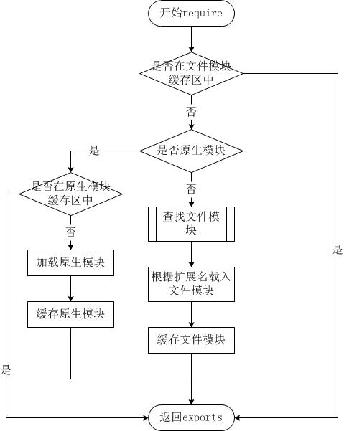
Node Module—Load Module
Notes:
模块引入：路径分析，文件定位，编译执行
载入内置模块（A Core Module）
var http = require('http')
载入文件模块（A File Module）
var myMod = require('/home/base/my_mod')
var myMod = require('./my_mod')
载入文件目录模块（A Folder Module）Node会假设folder为一个包并试图找到包定义文件package.json。如果folder目录里没有包含package.json文件，Node会假设默认主文件为index.js，即会加载index.js。如果index.js也不存在，那么加载将失败。
var myMod = require('./folder')
载入node_modules里的模块，如果模块名不是路径，也不是内置模块，Node将试图去当前目录的node_modules文件夹里搜索。如果当前目录的node_modules里没有找到，Node会从父目录的node_modules里搜索，这样递归下去直到根目录。
自动缓存已载入模块

Slide 49
Node Module
Module compilation
NodeJS will package the JavaScript with below code ‘(function (exports, require, module, __filename, __dirname) {\n’ in the head and ‘\n});’ in the end
Variable scope isolation between module files
Independent of each other
Notes:
Node对获取的JavaScript进行了头尾封装，在头部添加了(function (exports, require, module, __filename, __dirname) {\n，在尾部添加了\n});
模块文件之间作用域隔离

Slide 50
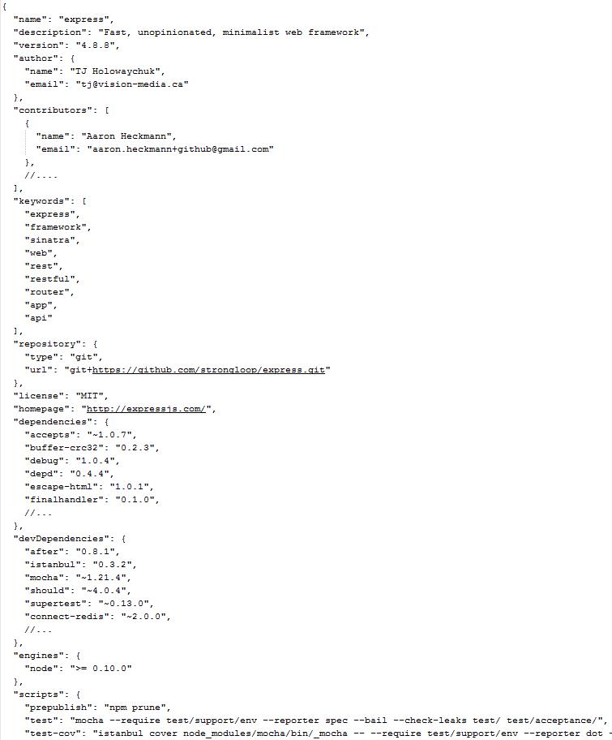
Package
package.json
bin
lib
doc
test
Notes:
在第三方模块中，模块与模块之间仍然是散列在各地的，相互之间不能直接引用。而在模块之外，包和NPM则是将模块联系起来的一种机制。
Bin: 可执行二进制文件， lib:javascript 代码， doc: 文档， test: 测试用例

Slide 51
Package
name
description
version
author
contributions
dependencies
devDependencies
keywords
repository
main
bin
scripts
engines
Notes:
Main: require 引入时查找
Bin:脚本

Slide 52
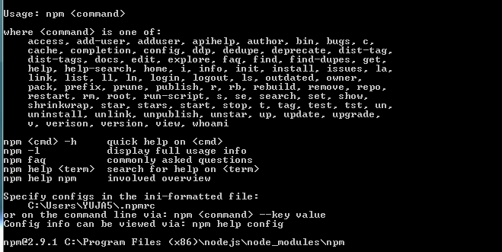
NPM
npm init
npm adduser
npm publish
npm install
npm owner
npm ls
Notes:
Init: 生成package.json 文件
Adduser: 建立仓库账号
上传包
安装包
管理包权限
分析包 当前路径通过模块路径找到的所有包，树结构

Slide 53
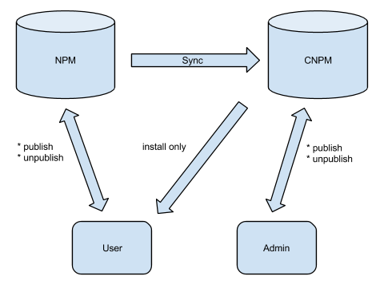
NPM
CNPM
npm install underscore --registry=http://registry.url
Notes:
官方、局域NPM仓库
CNPM 是一个Nodejs的库，致力于打造私有的 NPM 注册服务。当然，除了私有库功能以外，CNPM官网 (http://cnpmjs.org/) 还提供了NPM同步的服务。

Slide 54
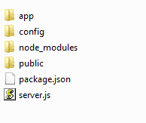
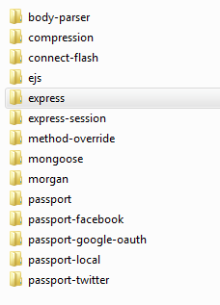
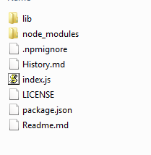
Project folder structure

Slide 55
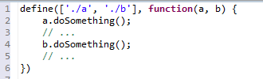
AMD Standard Asynchronous Module Definition
define(['dep1', 'dep2'], function (dep1, dep2) {
return function () {};
});
Notes:
Node 是隐式包装
所有的模块将被异步加载，模块加载不影响后面语句运行。所有依赖某些模块的语句均放置在回调函数中。
require获取依赖模块，使用exports导出API
1. 定义封装的模块。
2. 定义新模块对其他模块的依赖。
3. 可对其他模块的引入支持。

Slide 56
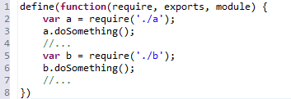
CMD Standard Common Module Definition
define(factory);
define(function(require, exports, module) {
// The module code goes here
});
Notes:
CMD 推崇依赖就近，AMD 推崇依赖前置
// CMD
define(function(require, exports, module) {
var a = require('./a')
a.doSomething()
// 此处略去 100 行
var b = require('./b') // 依赖可以就近书写
b.doSomething()
// ...
})
// AMD 默认推荐的是
define(['./a', './b'], function(a, b) { // 依赖必须一开始就写好
a.doSomething()
// 此处略去 100 行
b.doSomething()
// ...
})

Slide 57
Javascript Code Standard
http://zhairis4-w7:8090/JsStandard/standard.html
Notes:
小驼峰式命名
不要使用"相等"（==）运算符，只使用"严格相等"（===）运算符。

Slide 58
Reference
《深入浅出Node.js》
\\zhairis4-w7\Share\MEAN\NodeJS and Express

